Slide 1
CSS Gradients

Slide 2
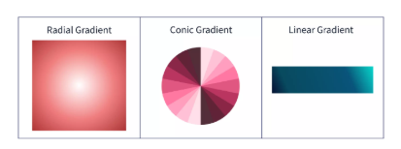
CSS Gradients
Gradients are the combination of two or more colors (where one color fades into another) and display the smooth transition between the nearest points of colors on our website.
CSS Gradients are background images set in three forms that are: -
linear-gradient - The transition between two or more colors occurs along a linear direction in a linear gradient.
radial-gradient - The color gradient begins from the center of its radial gradient.
conic-gradient - The transition between colors occurs around the center.

Slide 3
CSS Linear Gradient
Linear Gradient is the most common type of gradient. We can set the gradient axis from top to bottom, left to right, diagonally, or at any angle we want.
background-image: linear-gradient(direction, colour 1, colour 2,..);
direction (optional): Specifies the direction of the gradient. It can be in degrees (e.g., 90deg, 180deg) or using predefined keywords like to right, to top, to left, to bottom etc.
it takes the top to bottom direction by default.
Ex: background-image: linear-gradient(to right, red, blue);
Color-1, color-2, ...: A series of color values (colors or rgba, hsla, etc.), optionally including position percentages or lengths to define where the colors begin and end.
Ex: background-image: linear-gradient(90deg, red 10%, yellow 50%, green 90%);
Ex: background-image: linear-gradient(180deg, red 0px, yellow 100px);

Slide 4
CSS Radial Gradient
A radial gradient in CSS is a gradient where the color transition radiates outward from a central point (usually the center of the element), creating a circular or elliptical shape. Unlike linear gradients, which follow a straight line, radial gradients create a smooth transition that spreads outward in all directions.
background-image: radial-gradient(shape size at position, color1, color2, ...);
shape (optional ): Specifies the shape of the gradient. It can be:
circle (default): The gradient has a circular shape.
ellipse: The gradient has an elliptical shape.
Ex: background-image: radial-gradient(ellipse, red, blue);
at position (optional): Specifies the starting point of the gradient. You can use center, top left, 50% 50%, etc. By default, it starts at the center of the element.
Ex: background-image: radial-gradient(circle at top left, red, yellow);

Slide 5
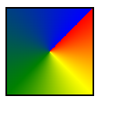
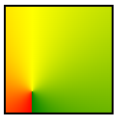
CSS Conic Gradient
To set the shape of the cone, we have to rotate the shape from the center. To do that, we will use the conic-gradient() function. It is slightly different from radial-gradient because the transition between colors is placed around the circle, while in radial, it emerges from the circle.
background-image: conic-gradient([from angle] [at position,] color 1, color 2 ...);
from angle (optional): Specifies the starting angle of the gradient. The angle is measured in degrees (deg), where:
0deg is at the top (12 o'clock),
90deg is to the right (3 o'clock),
180deg is at the bottom (6 o'clock),
270deg is to the left (9 o'clock).
If no angle is provided, the default starting angle is 0deg.
at position (optional): Specifies where the gradient should be centered. You can use values like center, top left, 50% 50%, etc. By default, the position is center.
Ex: background-image: conic-gradient(from 45deg, red 0%, yellow 25%, green 50%, blue 100%);
background-image: conic-gradient(from 180deg at 25% 80%, red, yellow, green);

Slide 6
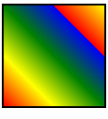
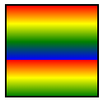
Repeating and Mixing
We can repeat colors in all three types of gradients.
Repeating Linear Gradient
We can repeat colors in a linear gradient using the repeating-linear-radient() function.
background-image: repeating-linear-gradient([direction], color1 [position1], color2 [position2], ...);
[direction] (optional): Specifies the direction of the gradient (e.g., to right, to bottom, or in degrees like 90deg, 180deg, etc.).
color1 [position1], color2 [position2], ...: Specifies the colors and optional position values (like percentages or lengths) where each color should appear in the gradient.
If no direction is provided, the default is top to bottom (from 0deg).
The repeating linear gradient will continue infinitely as the gradient pattern repeats itself.
Ex: background-image: repeating-linear-gradient(to bottom, red, yellow 20%, green 40%, blue 60%);
background-image: repeating-linear-gradient(45deg, red, yellow 25%, green 50%, blue 75%);

Slide 7
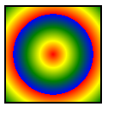
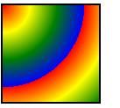
Repeating Radial Gradient
We can repeat radial gradient using repeating-radial-gradient() function.
background-image: repeating-radial-gradient([shape size at position], color1 [stop1], color2 [stop2], ...);
Ex: background-image: repeating-radial-gradient(circle, red, yellow 20%, green 40%, blue 60%);
Ex: background-image: repeating-radial-gradient(circle at top left, red, yellow 20%, green 40%, blue 60%);

Slide 8
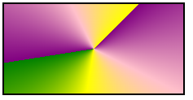
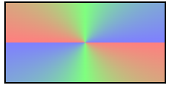
Repeating Conic Gradient in CSS
A repeating conic gradient is similar to a regular conic gradient, but instead of transitioning once around the center, it repeats infinitely in a circular fashion. This creates a continuous, tiled effect with alternating color segments.
background-image: repeating-conic-gradient([from angle] [at position], color1 [degree1], color2 [degree2], ...);
Ex: background-image: repeating-conic-gradient(from 45deg, purple, pink 20%, yellow 40%, green 60%);
Ex: background-image: repeating-conic-gradient(from 90deg, rgba(255, 0, 0, 0.5), rgba(0, 255, 0, 0.5) 25%, rgba(0, 0, 255, 0.5) 50%);

